Slide 1
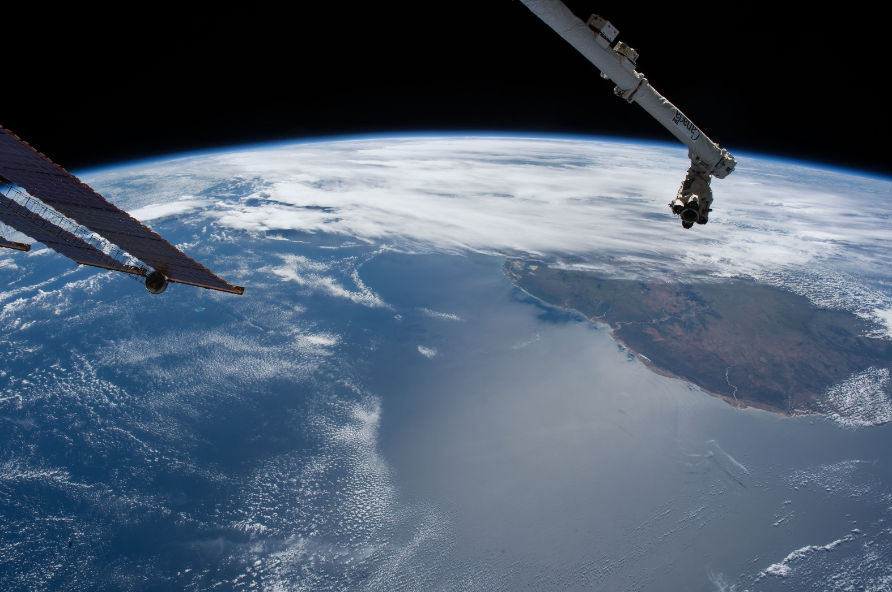
Using Computer Vision Techniques for Feature Detection in Astronaut Photography
Leslie R. Mayer
ESRS

Slide 2
What is Computer Vision?
Computer vision tasks include methods for acquiring, processing, analyzing and understanding digital images, and extraction of high-dimensional data from the real world in order to produce numerical or symbolic information, e.g., in the forms of decisions.
Computer vision - Wikipedia
https://en.wikipedia.org/wiki/Computer_vision

Slide 3
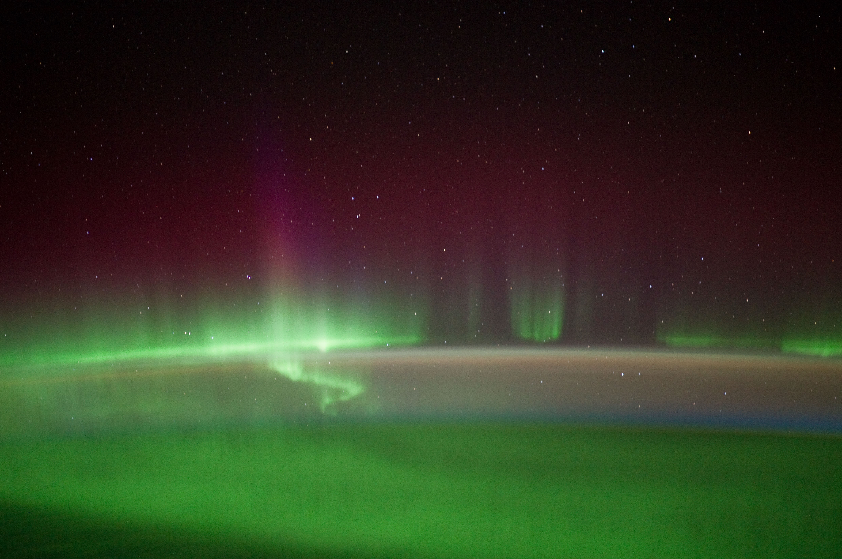
Aurora Detection

Slide 4
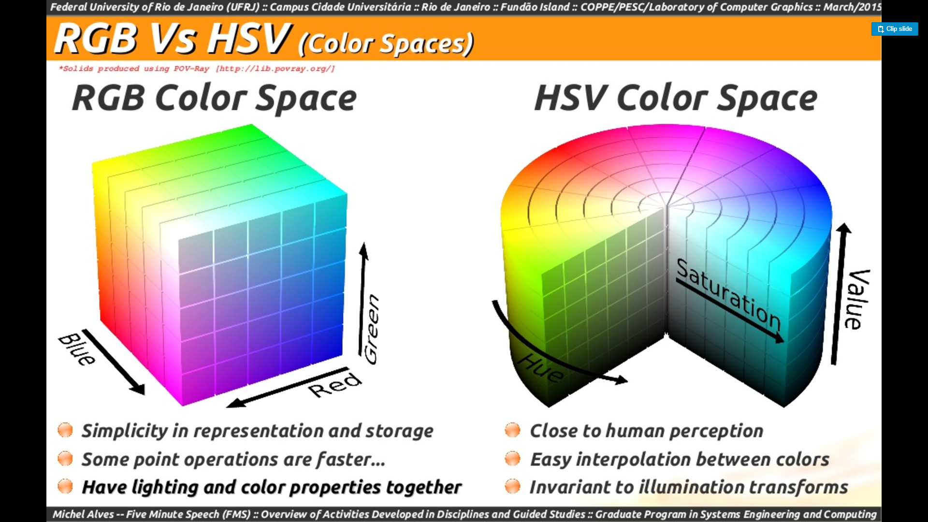
Detecting Aurora :
Check the sun elevation (only want to look at nightime images), reduce noise with a Gaussian filter, and convert the RGB Color Space to HSV Color Space. The algorithm is tuned to select pixels in a specified Hue, Saturation, and Value range.
Sample Python Code for Checking HSV Color Range :
colorLower = np.array([100, 30, 100], dtype="uint8") colorUpper = np.array([155, 150, 255], dtype="uint8")
mask = cv2.inRange(image, colorLower, colorUpper)

Slide 5
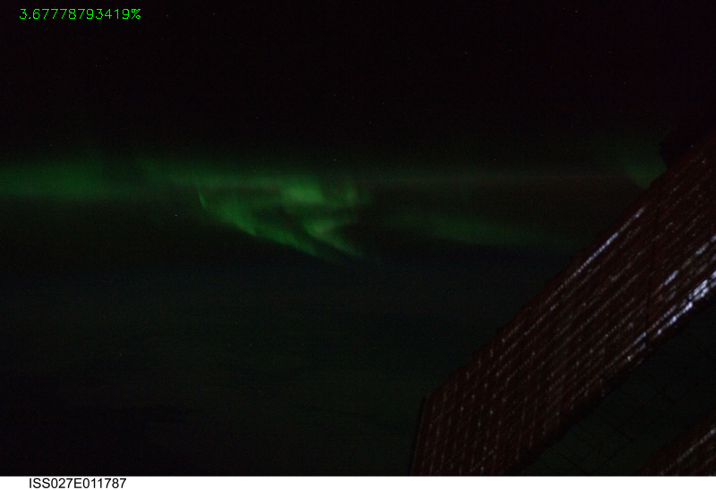
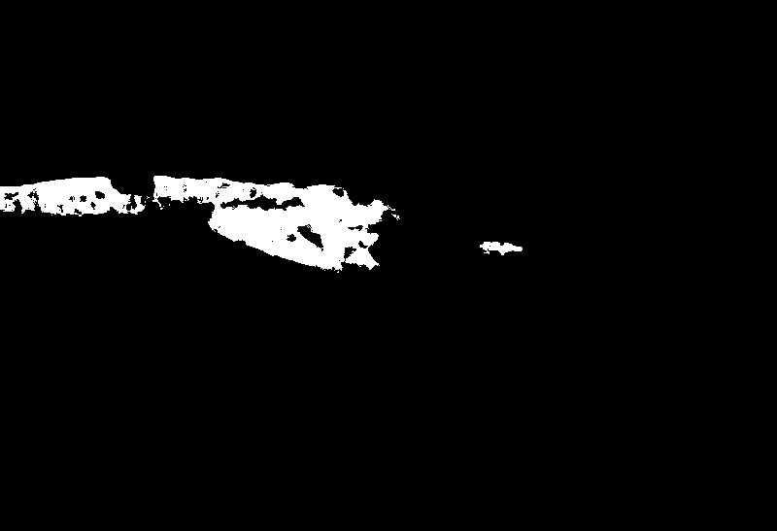
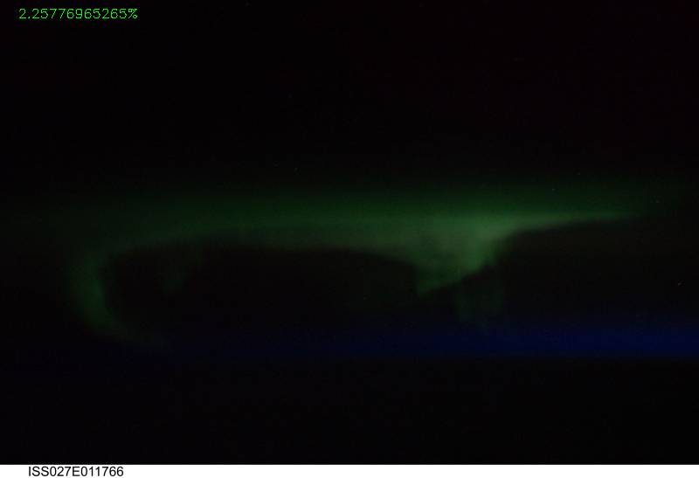
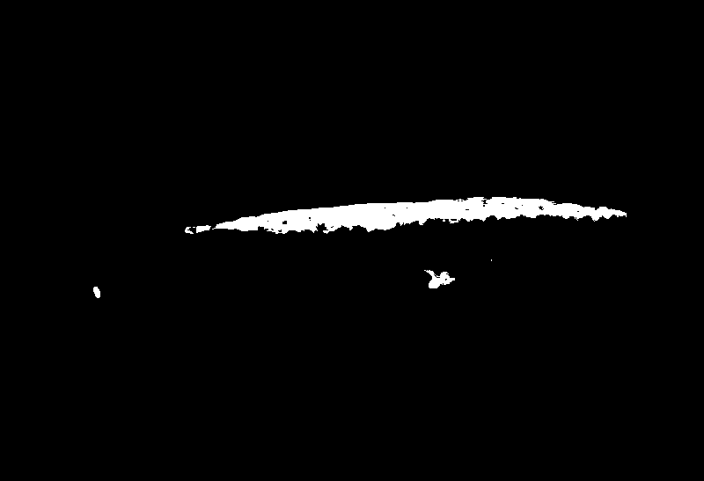
Result of checking pixels for the bright green color of an aurora :

Slide 6
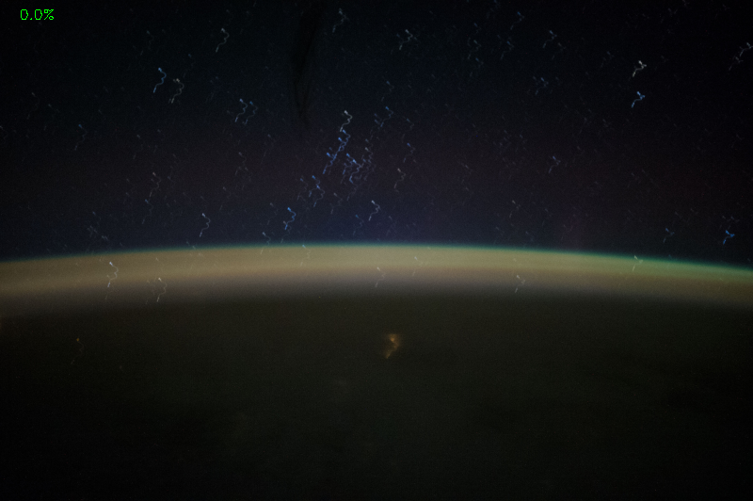

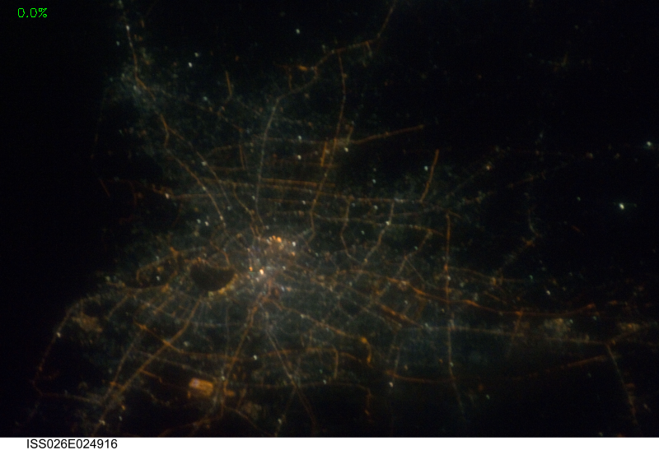
Algorithm is tuned to only detect aurora and not airglow or green city lights

Slide 7
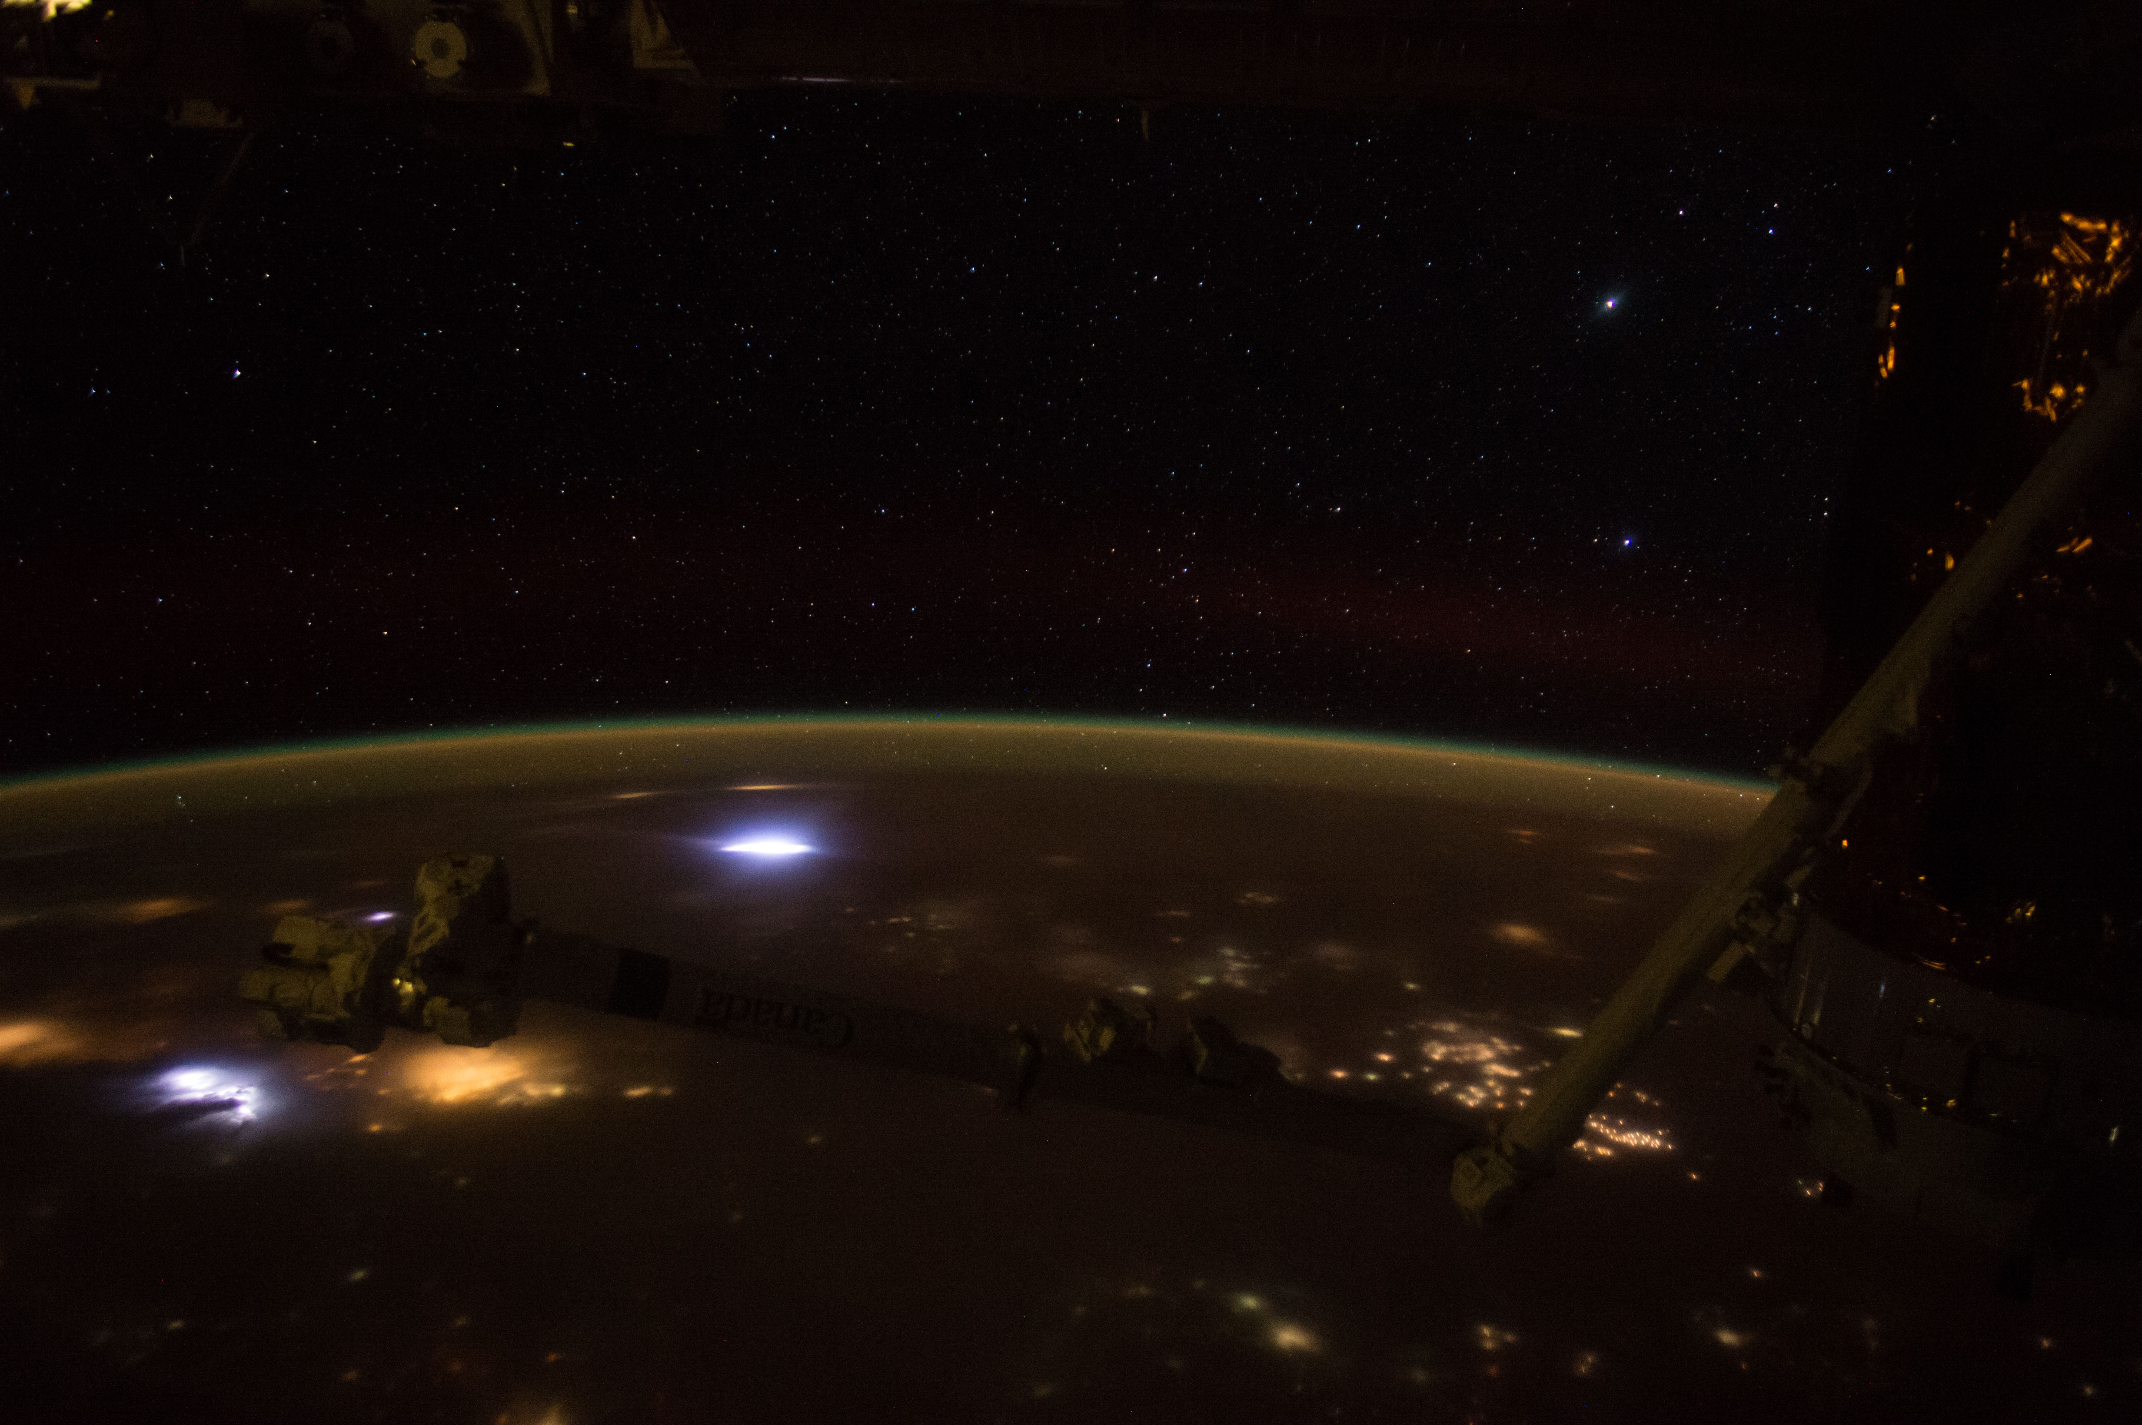
Lightning Detection

Slide 8
Detecting Nighttime Lightning :
The algorithm uses a combination of bilateral filtering, morphological opening, blob detection, and color masking.
Bilateral Filter : Reduces unwanted noise while keeping edges fairly sharp
Morphological Opening : Used to remove very small, bright objects
Blob Detection : Detects a group of connected pixels that share a common property. Tunable parameters are size, shape, convexity, inertia ratio, and whether blobs are light or dark.
Color Masking : Use HSV color space to check to see if blob is the right color (want to get rid of city lights)

Slide 9
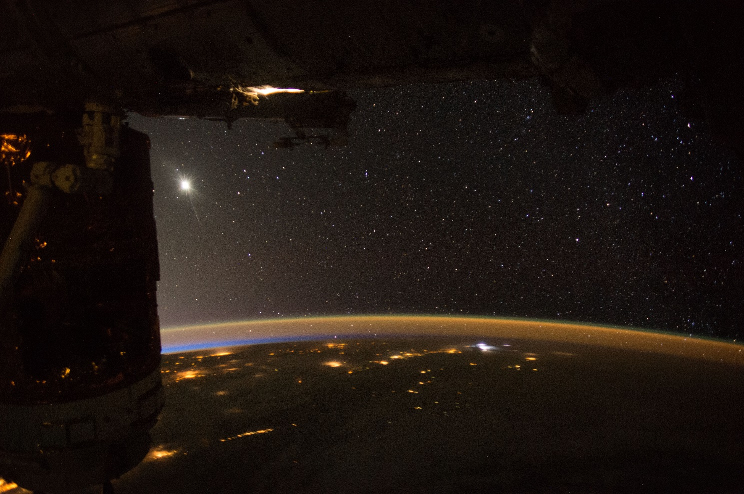


Original Image
Bilateral Filter
Morphological Opening

Slide 10
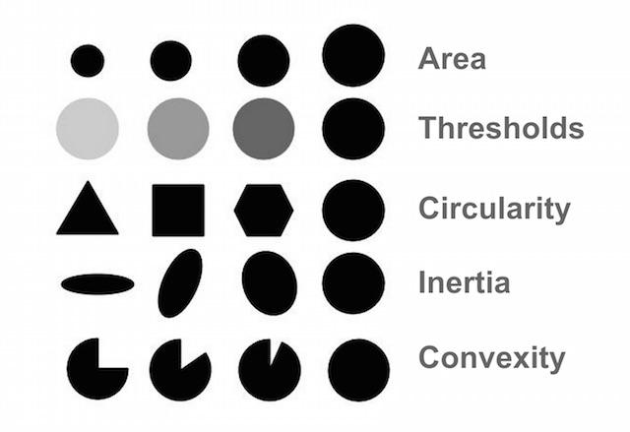
Examples of Blob Detection Tunable Parameters
www.learnopencv.com/blob-detection-using-opencv-python-c

Slide 11
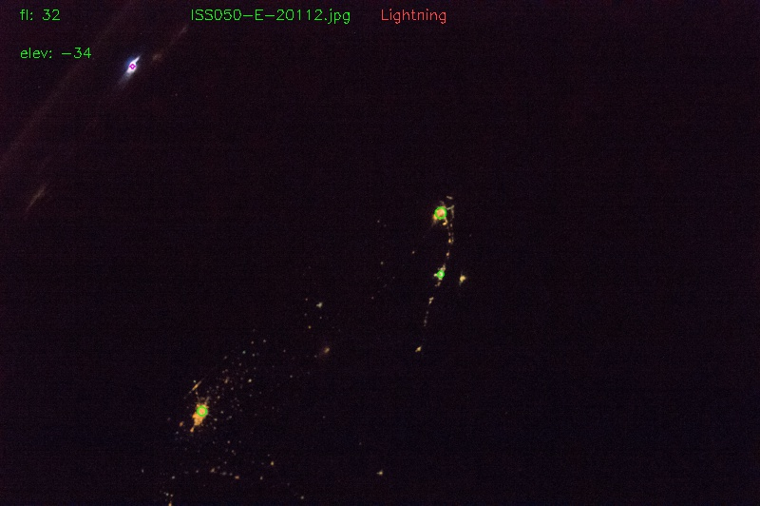
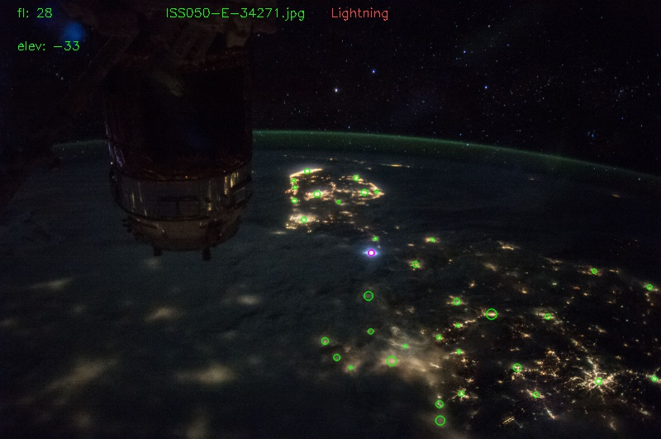
Lightning Algorithm Results :
Purple circles are detected blobs whose color is within the specified color range.
Green circles are detected blobs whose color is outside the specified color range.

Slide 12

Cloud Detection

Slide 13
Cloud Detection Algorithm:
Uses a combination of grayscale histogram equalization, texture, machine learning, and a sliding window.
Histogram Equalization : Enhance the contrast with a Contrast Limited Adaptive Histogram Equalization (CLAHE).
Local Binary Pattern Descriptor : Describes the local texture of a pixel. A normalized histogram of the LBP is used as the feature space for the machine learning model.
Machine Learning Classifier : A trained Support Vector Machine which uses a sliding window as the input image.

Slide 14
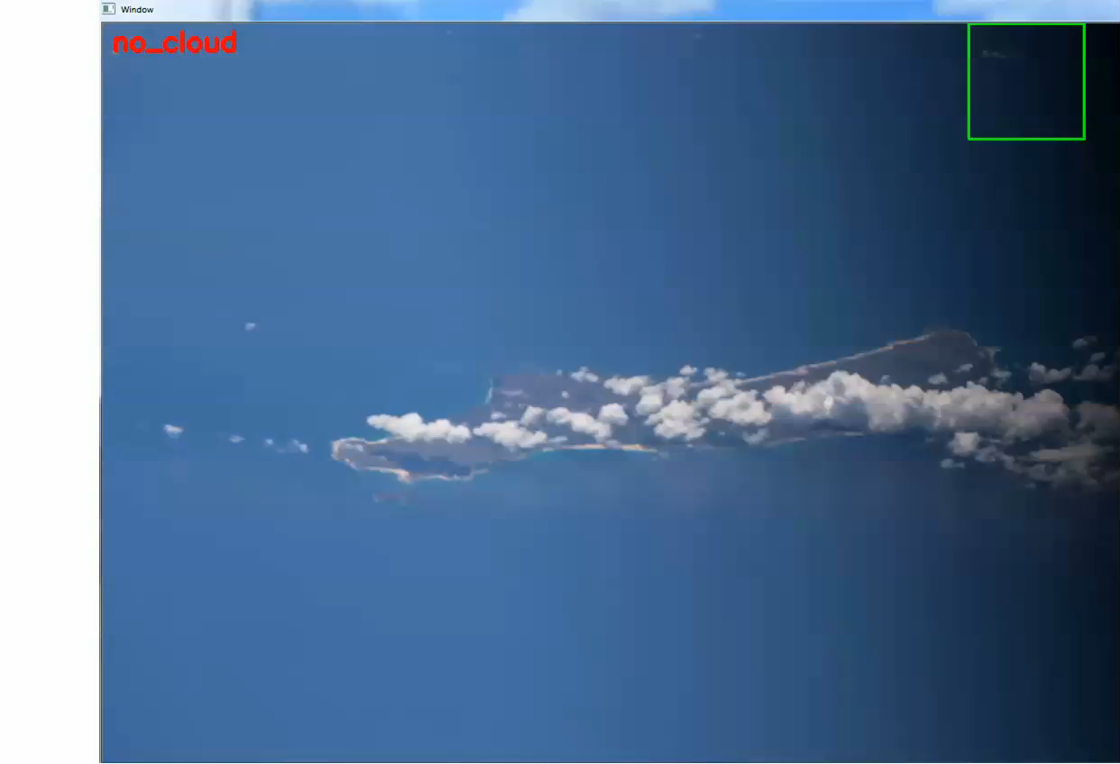

Slide 15
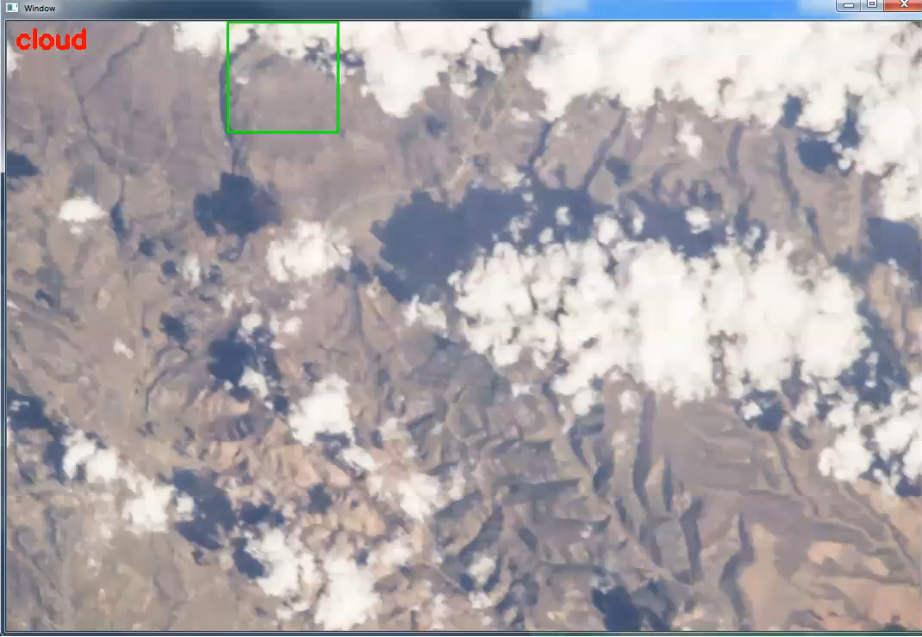

Slide 16
Furture Enhancements to the SVM Classifier :
1. The current classifier was trained with only 48 training images, but many more need to used. To do this quickly and automatically, cloud training sample images will generated by using a list of images that are all cloud, and within each image use a sliding window and save the window as a training image.
Create non-cloud sample images with the same process.
2. Add color to the feature space.
3. Further define what is cloud, non-cloud inside the sliding window.

Slide 17
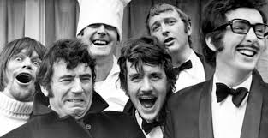
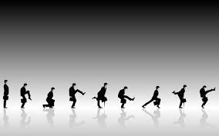
Software Language Used for All of the Computer Vision Algorithms :
Python and python libraries : OpenCV, Sklearn, Numpy

